Slide 1

Sensron+
STL Solution for Physical Security
www.sterlitetech.com

Slide 2

About Us
Customer Base
Network Concerns & Solution
Border Concerns & Solution
STL has the KEY
Partner Ecosystem

Slide 3
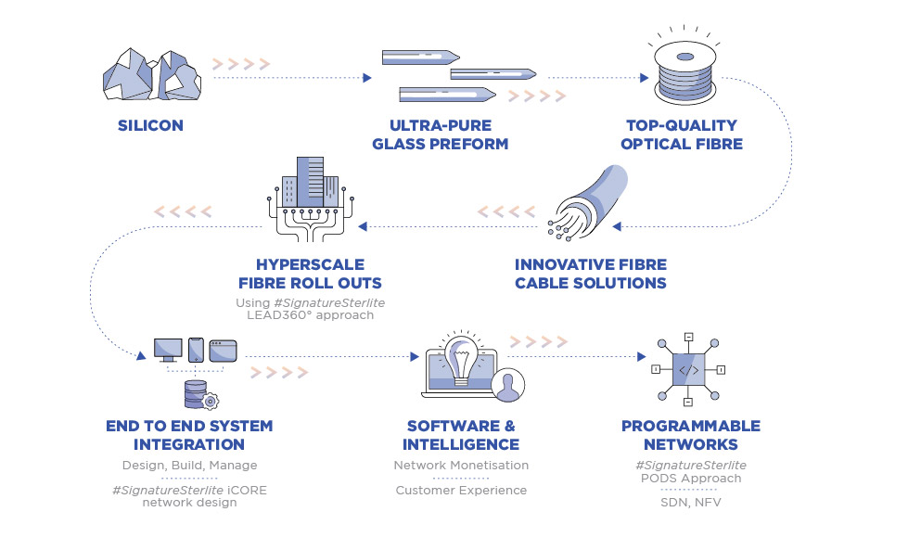



We are STL, a unique silicon to software company, unparalleled in the world
CONNECTIVITY
SOLUTIONS
NETWORK SERVICES
NETWORK
SOFTWARE
3

Slide 4


We have the experience and the expertise
All-Stack Capability
Only company in the world
Integrated across the network stack
Global Experience
43% revenue from exports
Partnering with 7 of Top 10 Telcos globally
Collaborating with Top 2 Cloud companies
beyond tomorrow
Technology Focused
271 Patents
3 Innovation Centres
IITs, Rutgers Academia Connect
End to End Solutions
Mobility | Access | Long Haul Connectivity
Network Modernization | Data Centre

Slide 5

About Us
Customer Base
Network Concerns & Solution
Border Concerns & Solution
STL has the KEY
Partner Ecosystem

Slide 6
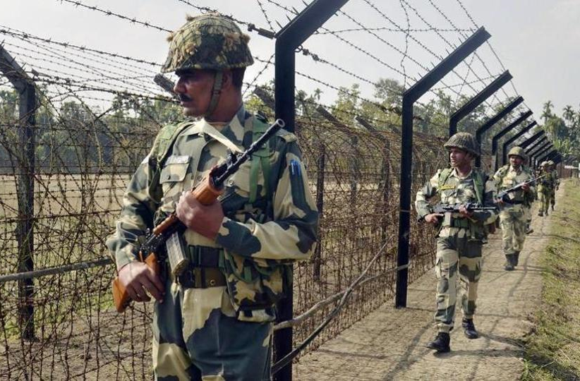
Customer Base
Territorial Border Security
SEGMENTS
Ports - Seaports

Slide 7
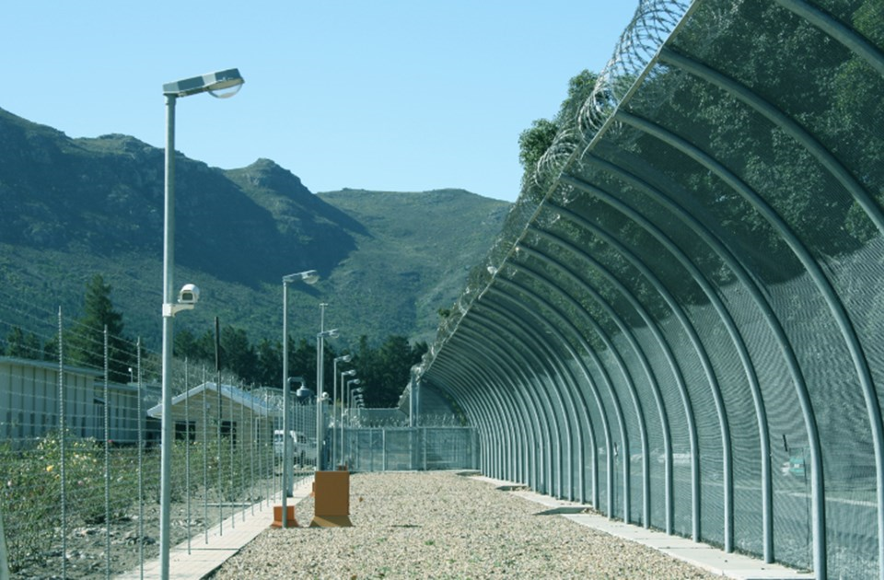
Customer Base
Defence Cantonments
Ports - Airport
SEGMENTS
Oil & Gas
Nuclear Power Plants

Slide 8

About Us
Customer Base
Network Concerns & Solution
Border Concerns & Solution
STL has the KEY
Partner Ecosystem

Slide 9
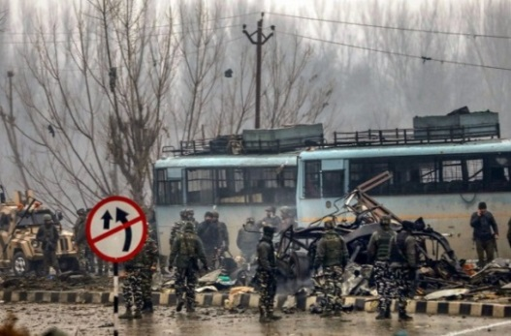

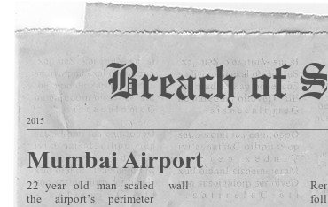
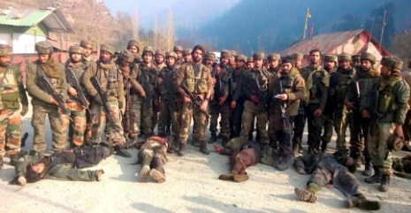
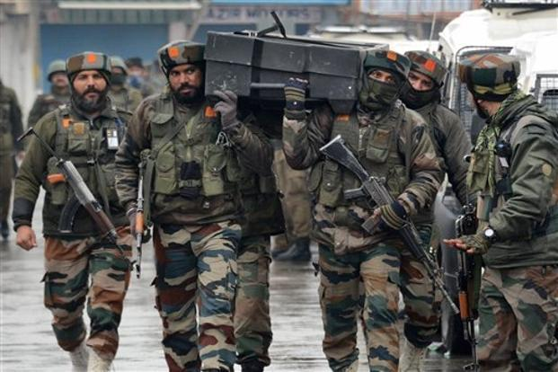
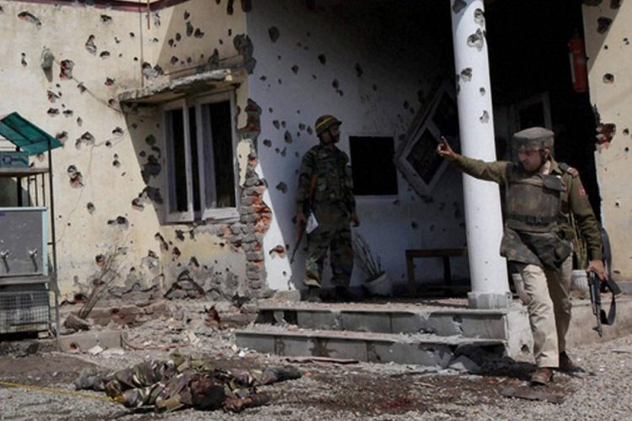
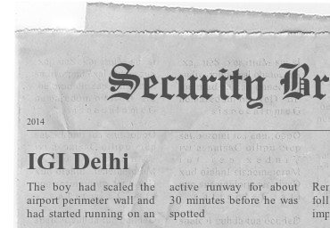
Concern Areas
Security Breaches
India
The desired level of security is missing in Defence & Military
Thousands of lives are getting sacrificed due to lack of proper security
From last 13 years Indian Army has been loosing its on duty soldier on every third day.
Death of Jawans in terror attacks rose by 106% in just J&K in 2018.
2019 Pulwama Attack
2016 Pathankot Attack
2018 Sunjuwan
Attack
2016 URI Attack

Slide 10
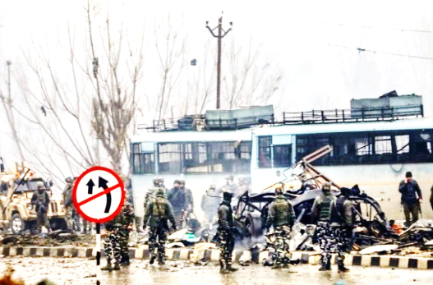
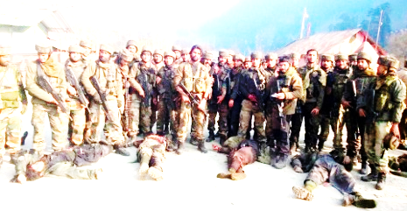
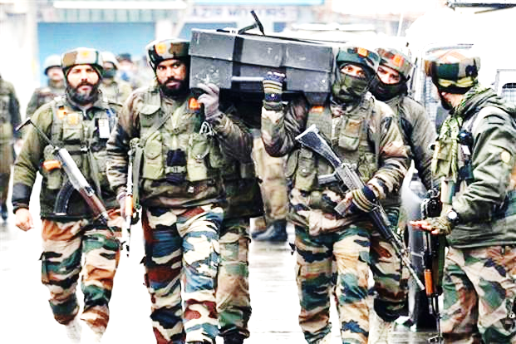
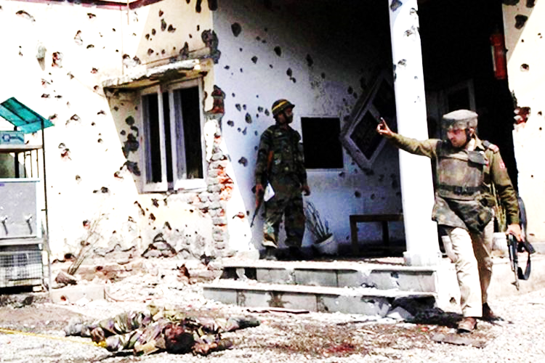
Concern Areas
Security Breaches
India
Defence or Military personal who are fighting all day all night to make sure we are safe, unfortunately themselves don’t have desired level of security
More than a life is sacrificed daily for safeguarding us mango people
Just Indian Army lost a soldier on duty every third day in past 13 years
Death of Jawans in terror attacks rose by 106% in just J&K last year
Absence of integrated approach & system
Unavoidable openings along perimeter
Easy visibility & access to close outsiders
False alarms due to animal intrusions
Harsh environmental conditions
Customer
Pain Points

Slide 11
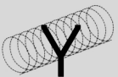



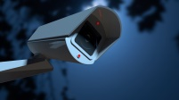


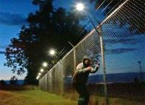

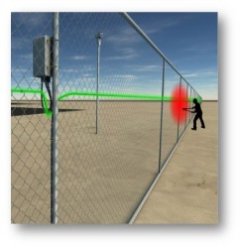
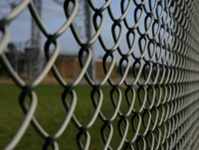

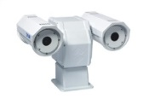
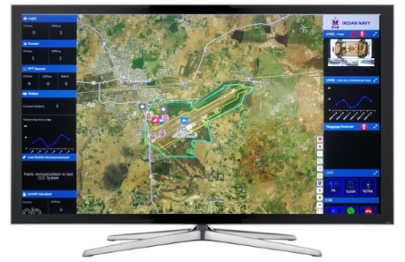
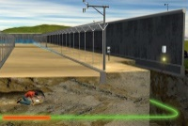
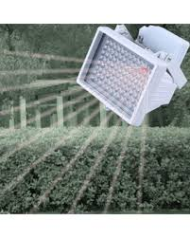
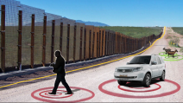

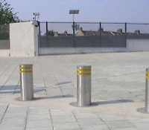
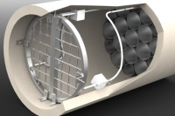
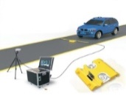



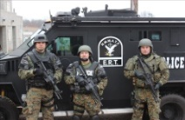
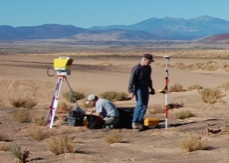
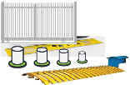


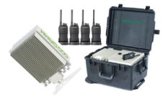
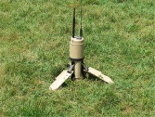
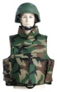
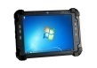
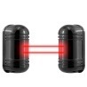
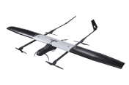



STL One Stop Solution
Lighting
Fencing
Integrated approach & system
Perimeter Light
Search Light
Anti Climb
Y Beam, Concertina
Laser Fence
Fixed CCTV
Surveillance
1
ESPF
Lighting
PTZ IR
Protection
Seamless protection for unapproachable areas
Surveillance
OFC based PIDS
Fencing
VMS, VA
PIDS
PTZ Thermal
2
Detection
Invisible protection for easy access areas
IR Illuminator
UVDS
OFC based PIDS
Access Control
3
UVSS
Verification
DIDS
Baggage Scanner
Access Control
Analytics resulting in collective useful outcome
Integrated Command & Control Center
4
Miscellaneous
Metal Detectors
Response
End Elements QRT
Gates, Bollard, Tyre Killer
RADAR
All weather robust rugged solution
LiDAR
CCC IT infra
U/VHF, Tabs
MW Sensor
QRT
Miscellaneous
LTE
PPG
UGS
IR Sensor
UAV
CAS
CCC IT Infra

Slide 12

About Us
Customer Base
Network Concerns & Solution
Border Concerns & Solution
STL has the KEY
Partner Ecosystem

Slide 13
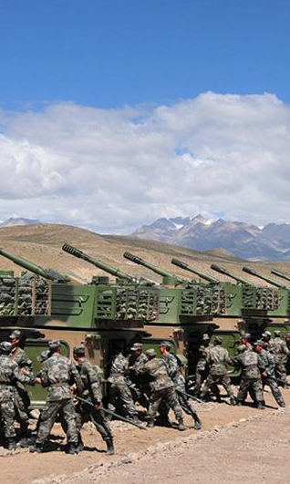
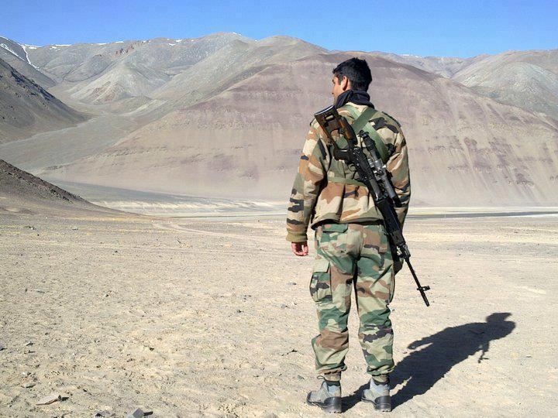
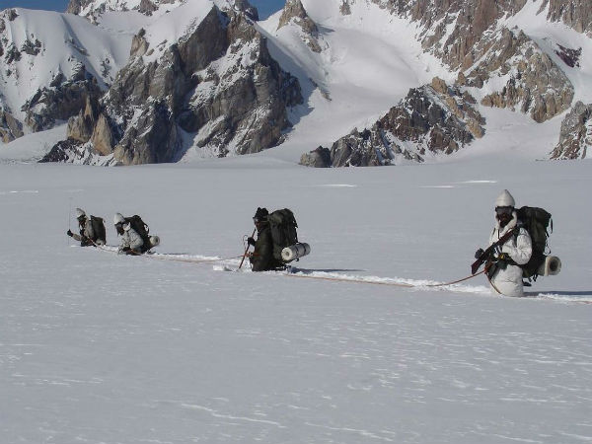
Border Security Concerns
Personnel requirement for 360 degree monitoring
Security of borders at challenging terrains
Being alert 24/7
In harsh areas

Slide 14
Border Security Concerns
Personnel requirement for 360 degree monitoring
Land Border Country | Length (km) | Force
Bangladesh | 4,097 | Border Security Force
China | 3,380 | Indo-Tibetan Border Police and Special Frontier Force
Pakistan | 3,323 | Border Security Force
Nepal | 1,758 | Sashastra Seema Bal
Myanmar | 1,643 | Assam Rifles and Indian Army
Bhutan | 600 | Sashastra Seema Bal
COVERAGE AREA
Security of borders at difficult terrains
Being alert 24/7
In harsh areas

Slide 15
Border Security Concerns
Personnel requirement for 360 degree monitoring
HUMAN CASUALITIES
Year | Number of ceasefire violations/cross border firings | Casualties of BSF Personnel
 |  | Martyred | Injured
2017 | 971 | 4 | 14
2018 | 2140 | 14 | 53
2019 till 31st Jan | 216 | 1 | 2
Security of borders at difficult terrains
Being alert 24/7
In harsh areas

Slide 16
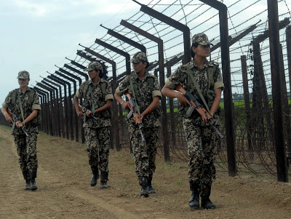
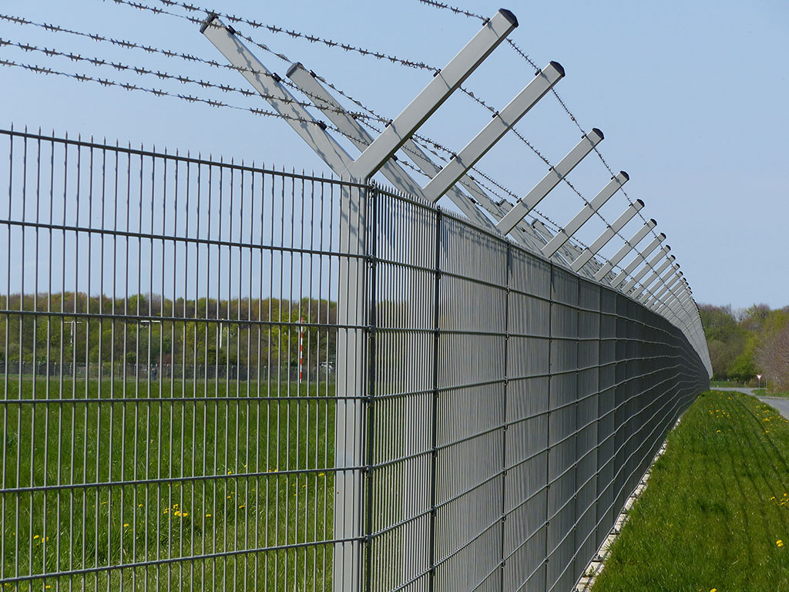
STL Security
Solutions
Integrated Border Security System
Integrated Perimeter Security System

Slide 17
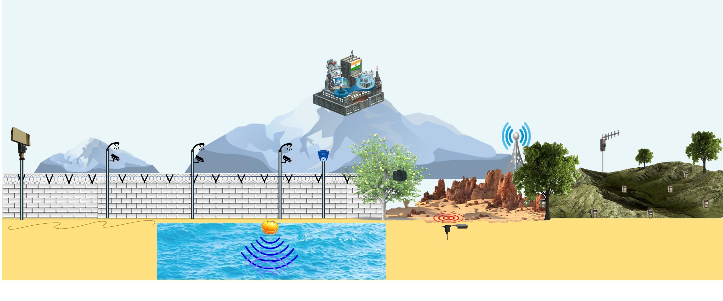






Integrated Border
Security System
Command & Control Center (CCC) + Data Center (DC)
Above Ground Level Field Components
RADAR (PSR)
PTZ Camera
OFC Fence Sensor (PIDS)
Fixed CCTV Camera
Underground Scenarios
UVDS
OFC Buried Sensor
SONAR & Hydrophone
Wireless Sensor
Unattended Ground Sensor (UGS)
Case 1: OFC Deployable ground (preferably non-concrete): UVDS
Case 2: Sea at border: SONAR
Case 3: Absence of Secure Boundary: Unattended Ground Sensor
Case 4: Absence of Secure Boundary: Wireless Sensor

Slide 18
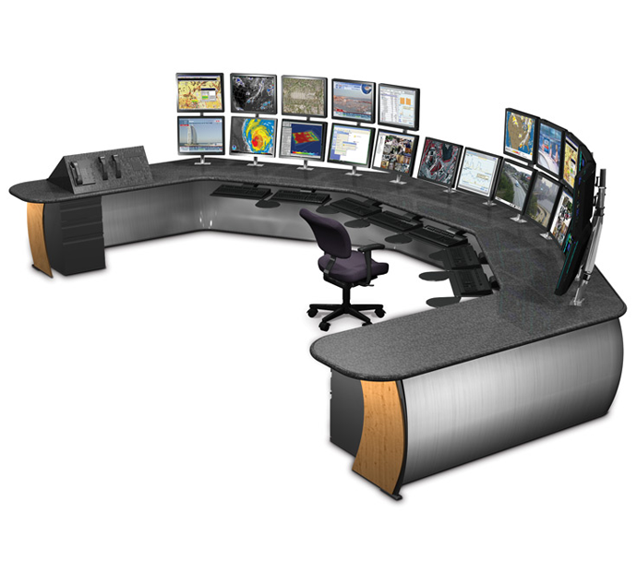
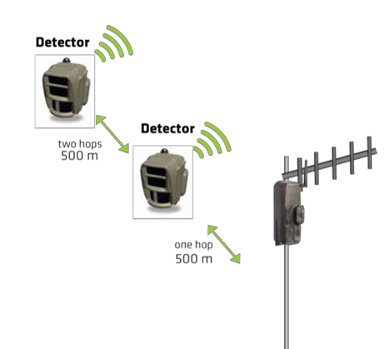

Integrated Border
Security System
1
Photo sensor with LTE backhaul
Photo sensor
Private network
Command and
control centre
Sensor Range: 38m
Connectivity: 80 Km

Slide 19
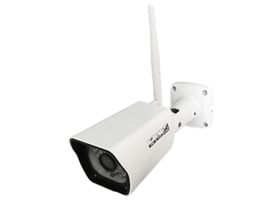
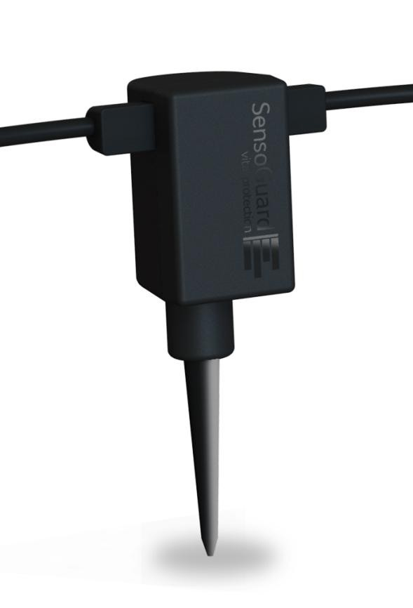

Integrated Border
Security System
2
Underground sensing & camera with LTE backhaul
Underground sensor with camera
Private network
Command and
control centre
Sensor Range: 8-12m radius
Connectivity: 80 Km

Slide 20

Uniqueness of Solution
End to end
Sustainable
Flexible
Rugged
Optimised
Innovative
Seamless backhaul
For all terrains
Photo sensor with LTE backhaul
Battery powered
Installation in less than 2 minutes
Integrated Border
Security System
Underground sensing & camera
with LTE backhaul
Battery powered
Underground installation

Slide 21
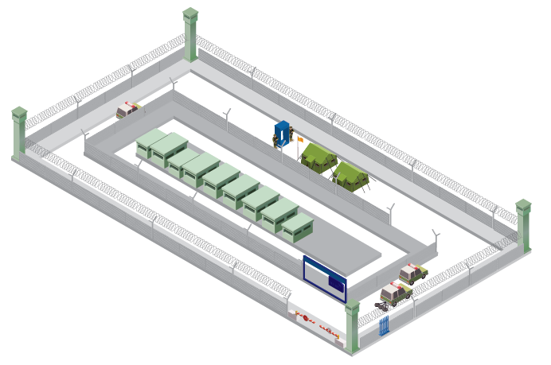
Integrated Perimeter
Security System
VISITOR MANAGEMENT SYSTEMS
PERIMETER LIGHT & CAMERAS
DIDS WITH FOCUSED SPOT LIGHT & CAMERA
PEDESTRIAN SANITIZATION METAL DETECTORS – DOOR FRAME & HANDHELD, BAGGAGE SCANNER
MICRO-UAV
PROTECTIVE GEAR
V/UHF COMM SET
RUGGEDISED TABS
ANTI CLIMB FENCE, CONCERTINA COIL, Y BEAMS
MOBILE CCC
FIBRE OPTIC FENCE SENSOR CABLE
Y BEAMS & CONCERTINA COILS ON PERIMETER WALL
GROUND LAID CONCERTINA
VEHICLE SANITIZATION UVSS,SLIDING GATES, BOLLARDS & TYRE SHREDDERS
MOBILE BULLET SENTRY POST
GATE WITH RFID
INTEGRATION OF POWER FENCING

Slide 22

Uniqueness of Solution
End to end
Sustainable
Flexible
Rugged
Optimised
Innovative
Seamless backhaul
Integrated Perimeter
Security System

Slide 23

About Us
Customer Base
Network Concerns & Solution
Border Concerns & Solution
STL has the KEY
Partner Ecosystem

Slide 24

STL’s KEY:
How we make difference
End To End Approach
100% Intrusion Proof
Quick Response Time
Sensron+
Integrated & Optimised Solution
Rugged Solution
Lesser False Alarm Rate

Slide 25

www.sterlitetech.com

Slide 26

About Us
Customer Base
Network Concerns & Solution
Border Concerns & Solution
STL has the KEY
Partner Ecosystem

Slide 27




































Technology Partner Ecosystem
Optical Fibre based Sensing Solution
Command Control Centre & IT Solution
Security Infrastructure Setup
Other Infra Setup & Miscellaneous

